Slide 1
Security+
Certification Prep Day 2

Slide 2

Class Objectives
By the end of class, you will be able to:
Explain how each domain is divided across the Security+ exam.
Prepare for Security+ questions from domains and topics we have not explored in the curriculum, such as Architecture and Design and Identity and Access Management.
Correctly answer Security+ practice questions.

Slide 3

The first half of today's class will focus on several domains on the exam and the types of questions they contain.
The second half of the class will be a fun quiz competition using a program called Kahoot.
3

Slide 4
Security+ Domains

Slide 5
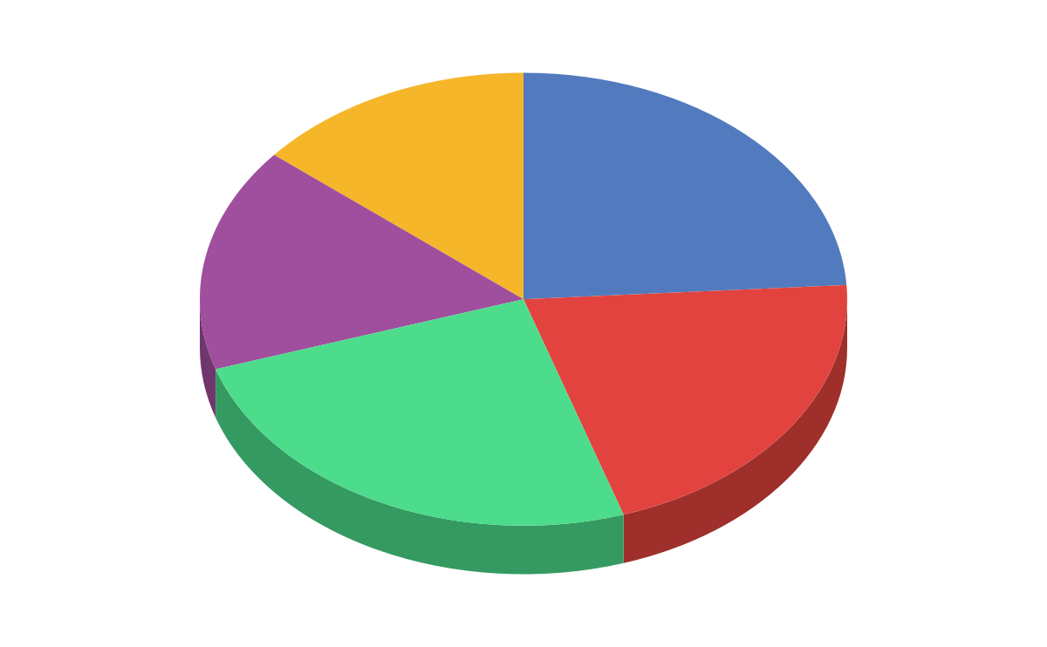
Security+ Exam Topics Breakdown
Domain Distribution
01
Attacks, Threats and Vulnerabilities
14.0%
24.0%
02
Architecture and Design
16.0%
03
Implementation
21.0%
04
Operations and Incident Response
25.0%
05
Governance, Risk and Compliance

Slide 6
Today, we’ll take some time to look at the identity and management topic and the Architecture and Design domain.
6

Slide 7
Identity & Access Management (IAM)

Slide 8

Identity and Access Management
Identity and Access Management is a topic covered across multiple Security+ domains.
It covers the security policies that ensure an organization's resources are only accessible by the right people, for the right reasons, at the right times.
There are significant risks to incorrectly assigning access to resources.
Notes:
shutterstock_1407023006

Slide 9

Identity and Access Management
For example, if an organization gives all staff access to payroll databases, the staff would be able to access PII and other private data of the organization and its employees.
Notes:
shutterstock_672553726

Slide 10
Identity and Access Management
Across the different domains, there are several subdomains that contain questions covering IAM.
Summarize authentication and authorization design concepts.
2.4
Given a scenario, implement authentication, and authorization solutions.
3.8
Notes:
shutterstock_679360057

Slide 11

This subdomain focuses on the basic terms and concepts associated with IAM, such as:
Authentication, Authorization, and Accounting (AAA): the framework to best control access to an organization’s resources.
2.4
Summarize authentication and authorization design concepts.
Types of authentication factors:
Something you are.
Includes biometrics, such as retina scanning or facial recognition.
Something you have.
Such as tokens or key-cards.
Something you know.
Such as PINs or passwords.
Notes:
shutterstock_679360057

Slide 12

Example Question:
Of the following authentication factors, which one is a different factor than a retina scan?
Hand geometry recognition
Voice recognition
Fingerprint recognition
Proximity cards
Notes:
Image source: shutterstock_1169662366

Slide 13
Example Question:
Of the following authentication factors, which one is a different factor than a retina scan?
Hand geometry recognition
Voice recognition
Fingerprint recognition
Proximity cards
Proximity cards are “something you have” while the other options are all biometric factors (“something you are”).
Notes:
Image source: shutterstock_1169662366

Slide 14
This subdomain focuses on the the application of the concepts associated with IAM, such as authentication protocols like Kerberos, CHAP, and PAP.
3.8
Given a scenario, implement authentication and authorization solutions
Kerberos
Kerberos is an authentication protocol developed at MIT that works using tickets.
PAP
Password Authentication Protocol (PAP) uses a standard username and password to authenticate to a remote system and is considered insecure.
CHAP
Challenge-Handshake Authentication Protocol (CHAP) uses a three-way handshake, making it more secure than PAP.
Notes:
shutterstock_679360057

Slide 15
Example Question:
Which of the following authentication protocols is considered insecure due to its lack of encryption?
EAP
SAP
PAP
CHAP
Notes:
Image source: shutterstock_1169662366

Slide 16
Example Question:
Which of the following authentication protocols is considered insecure due to its lack of encryption?
EAP
SAP
PAP
CHAP
PAP is insecure and unencrypted.
Notes:
Image source: shutterstock_1169662366

Slide 17

This subdomain also focuses on management decisions for making sure the right people have access to the right resources for the right reasons.
Various types of access controls include:
3.8
Given a scenario, implement authentication and authorization solutions
MAC
Mandatory Access Control (MAC)
DAC
Discretionary Access Control (DAC)
RBAC
Role Based Access Control (RBAC)
Notes:
shutterstock_631196210

Slide 18

This topic also focuses on selecting the best access controls based on your organization’s environment.
For example, voice recognition is an appropriate biometric control if your office environment is relatively quiet.
3.8
Given a scenario, implement authentication and authorization solutions.
Notes:
shutterstock_226014133

Slide 19
Example Question:
For the following biometric controls, which would you select if you have a noisy office with good lighting and need a cost-efficient solution?
Voice recognition
DNA analysis
Fingerprint recognition
Speech recognition
Notes:
If the class inquires about the difference between voice and speech recognition, explain that voice recognition detects the speaker based on the characteristics specific to the person, whereas speech recognition detects the words, absent of any unique accents, inflections or characteristics of the speaker.
Speech recognition is "what was said" and voice recognition is "who said it".

Slide 20
Example Question:
For the following biometric controls, which would you select if you have a noisy office with good lighting and need a cost-efficient solution?
Voice recognition
DNA analysis
Fingerprint recognition
Speech recognition
A and D would not be optimal in a noisy office, and B would likely be an expensive biometric solution.
Notes:
If the class inquires about the difference between voice and speech recognition, explain that voice recognition detects the speaker based on the characteristics specific to the person, whereas speech recognition detects the words, absent of any unique accents, inflections or characteristics of the speaker.
Speech recognition is "what was said" and voice recognition is "who said it".

Slide 21
This subdomain also focuses on how user accounts are managed, such as the concept of least privilege, which students should be familiar with.
3.8
Given a scenario, implement authentication and authorization solutions.
Account types:
User Accounts
The basic, standard account type for users at your organization. These accounts usually have limited privileges.
Guest Accounts
For non-employees who need limited access to your organization’s resources.
Privileged Accounts
Greater access than user accounts and are provided to managers and system administrators.
Notes:
shutterstock_679360057

Slide 22
Example Question:
An external auditor needs limited access to your organization. What type of account should you provide them?
Guest account
User account
Sudo account
Service account
Notes:
Image source: shutterstock_1169662366

Slide 23
Example Question:
An external auditor needs limited access to your organization. What type of account should you provide them?
Guest account
User account
Sudo account
Service account
You would provide a guest account to a non-employee who needs limited access.
Notes:
Image source: shutterstock_1169662366

Slide 24
Activity: Security+ IAM
In this activity, you will complete a quiz of PBQ and multiple choice questions from the Identity and Access Management topics.
15 Mins

Slide 26
Security+ Architecture and Design Domain

Slide 27

Architecture and Design covers the processes and controls used to protect the confidentiality, integrity, and availability of an organization's data.
Notes:
shutterstock_295452179

Slide 28
Architecture and Design
This domain consists of eight sub domains:
01
Explain the importance of security concepts in an enterprise environment.
02
Summarize virtualization and cloud computing concepts.
03
Summarize secure application development, deployment, and automation concepts.
04
Summarize authentication and authorization design concepts.
05
Given a scenario, implement cybersecurity resilience.
06
Explain the security implications of embedded and specialized systems.
07
Explain the importance of physical security controls.
08
Summarize the basics of cryptographic concepts.

Slide 29
Architecture and Design
This domain consists of nine sub domains:
01
Explain the importance of security concepts in an enterprise environment.
02
Summarize virtualization and cloud computing concepts.
03
Summarize secure application development, deployment, and automation concepts.
04
Summarize authentication and authorization design concepts.
05
Given a scenario, implement cybersecurity resilience.
06
Explain the security implications of embedded and specialized systems.
07
Explain the importance of physical security controls.
08
Summarize the basics of cryptographic concepts.

Slide 30
This subdomain focuses on the concepts and processes relevant to developing secure applications for organizations and their users.
For instance, input validation restricts what data can be input to application fields, such as limiting non-ASCII characters.
03
Summarize secure application development, deployment, and automation concepts.
Software development methodologies:
Agile
Agile is a flexible development method that allows changes to the development requirements.
Waterfall
Waterfall is a structured and rigid development method where each step of development cycle depends on the previous step.

Slide 31
Example Question:
What is the biggest risk of outputting detailed application errors with coding details?
There is no risk, and it is recommended.
Coding details could provide the developer’s name.
Coding details could illustrate vulnerabilities in the application code, which a hacker can then exploit.
Coding details could indicate when the code was written.
Notes:
Image source: shutterstock_1169662366

Slide 32
Example Question:
What is the biggest risk of outputting detailed application errors with coding details?
There is no risk, and it is recommended.
Coding details could provide the developer’s name.
Coding details could illustrate vulnerabilities in the application code, which a hacker can then exploit.
Coding details could indicate when the code was written.
Displaying the code details, such as the coding language, version and structure, could provide vulnerability information to hackers to exploit.
Notes:
Image source: shutterstock_1169662366

Slide 33
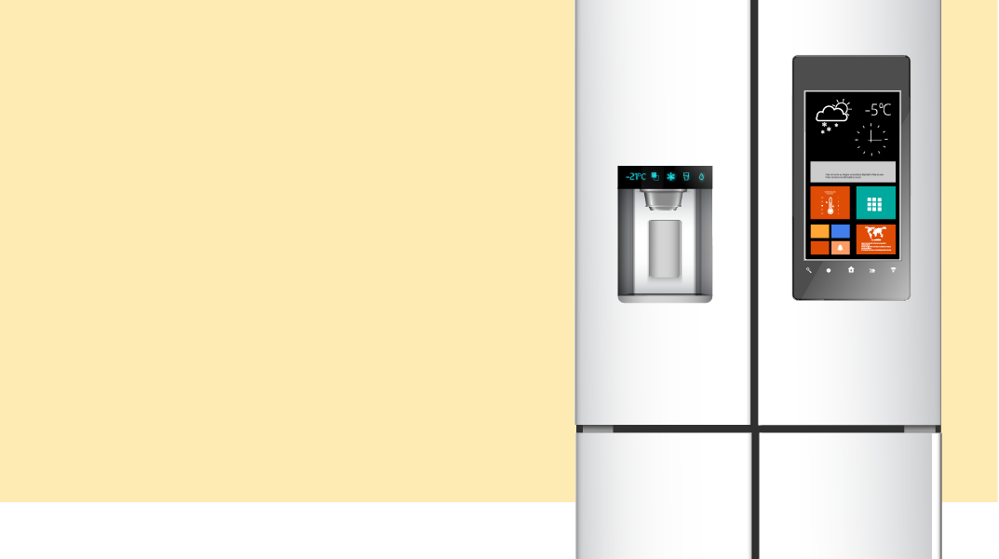
This subdomain focuses on the security of embedded systems, which are systems that have hardware with software embedded within them.
For example, a smart refrigerator is an example of an embedded system.
06
Explain the security implications of embedded and specialized systems.
A smart refrigerator has hardware and software embedded within it to complete specific tasks, such as:
Monitoring temperature.
Determining if a filter needs replacing.
Notes:
shutterstock_736270894

Slide 34
Architecture and Design
Terms to know include:
01
Supervisory Control and Data Acquisition (SCADA)
02
Internet of Things (IoT)
SCADA is a system used to control technical equipment in industries such as:
Energy
Oil
Water management
IoT is the network of devices that are connected to the internet, which is considered an extension of the internet itself.
Smart light bulbs
Smart refrigerators
Printers
Door locks

Slide 35
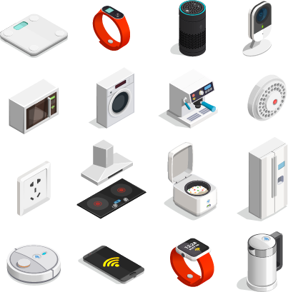
IoT is an expansive term relevant to many areas such as smart houses, research and monitoring in the healthcare industry, wearable devices such as step counters, data collection in agriculture, manufacturing and city management and many, many more.
Notes:
shutterstock_1024669366

Slide 36
Example Question:
To protect their data, which type of systems are usually not connected to the internet?
Linux servers
Apache web servers
SCADA systems
Home office networks
Notes:
Image source: shutterstock_1169662366

Slide 37
Example Question:
To protect their data, which type of systems are usually not connected to the internet?
Linux servers
Apache web servers
SCADA systems
Home office networks
While some SCADA systems have limited connection to the internet, they run high-impact systems, so are usually are not connected.
Notes:
Image source: shutterstock_1169662366

Slide 38
This subdomain focuses on concepts associated with physical security processes and controls.
07
Environmental Controls
Such as HVAC systems and fire suppression systems.
Explain the importance of physical security controls.
Physical Access Controls
Such as gates, man traps, and security guards.
Physical control types include:
Deterrents such as alarms.
Preventions such as locks or gates

Slide 39
Example Question:
What type of risk can a bollard protect against?
Fire
Flooding
Vehicle Access
Script Kiddies
Notes:
Image source: shutterstock_1169662366

Slide 40
Example Question:
What type of risk can a bollard protect against?
Fire
Flooding
Vehicle access
Script kiddies
A bollard is a short post that’s built into the ground to protect areas from vehicle access.
Notes:
Image source: shutterstock_1169662366

Slide 41
Activity: Security+ Architecture and Design
In this activity, you will take a quiz made of PBQ and multiple choice questions from the Architecture and Design domain.
15 Mins

Slide 43

Now, we will take part in a fun and challenging competition using:

Slide 44
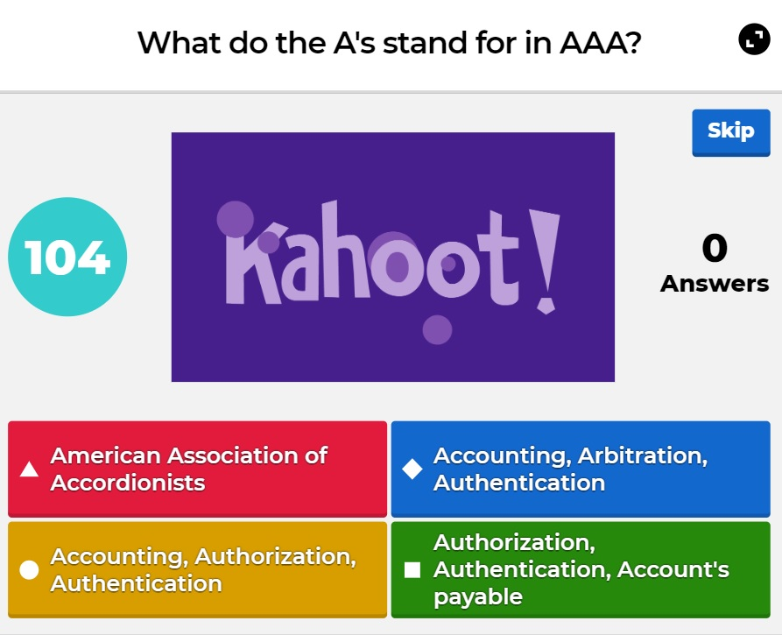

What’s Kahoot?
Kahoot is a web-based tool that:
Displays questions and answers for students to select from in real time.
Keeps track of individual and team scores.
Keeps track of remaining time for each question.
(kahoot.com)

Slide 45

Rules and Guidelines
There are a total of 30 Security+ questions.
Points are not deducted for incorrect answers.
You will have two minutes to answer each question.
If you are competing as a team, select a team captain to answer the questions.
Points are awarded for correct answers and for how quickly you answer the questions compared to your classmates.
Note: If your class is currently online, it will be easier if each student competes individually.
(kahoot.com)

Slide 46
Rules and Guidelines
The questions will come from any of the six Security+ domains.
Any issues will be decided by the judges (the TAs and/or instructor), e.g.:
Answer disputes
Frozen or lagging computers
Kahoot issues
You can use all available resources: books, the internet, class notes, etc.
The team or individual with the most points at the end of 30 questions is the winner!
(kahoot.com)

Slide 47
Activity: Kahoot Challenge
Now we’ll begin the competition!
1:00

